Slide 1
Model Context Protocol (MCP)

Slide 2
What is Model Context Protocol (MCP)?
MCP is a standard way for AI models (or custom agents) to connect safely with external tools, data, or APIs.
It defines how models exchange context — like what data they can access, what tools they can use, and what limits apply.
Think of it as a “universal adapter” that helps AI systems talk to other software easily.
It ensures security, structure, and consistency when LLMs interact with outside systems.
Created to make AI integrations modular, reusable, and open-standard, instead of custom code for each use case.
Helps multiple models and tools work together in one environment (for example, a chatbot fetching CRM data securely).
Notes:
Give a concise 45-second definition and then expand on why structured context matters.

Slide 3
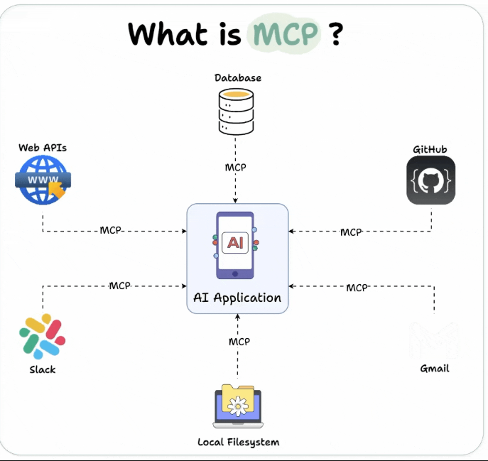
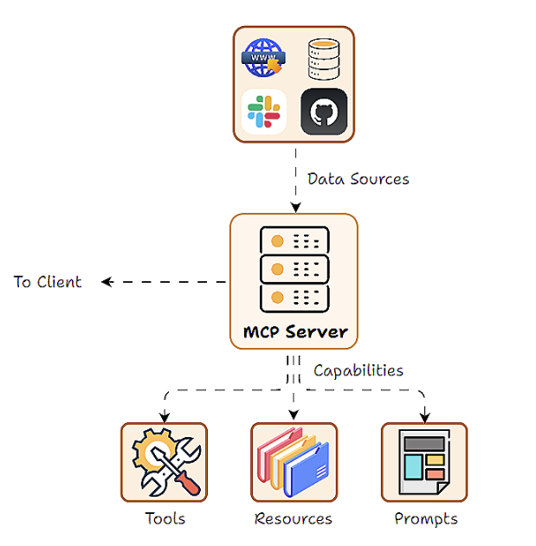
MCP Architectures

Slide 4
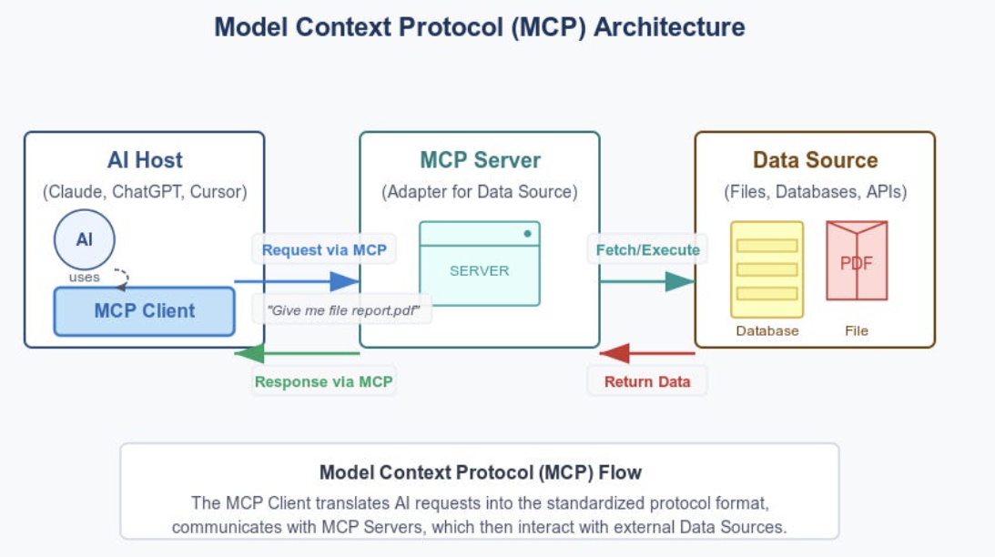

Slide 5
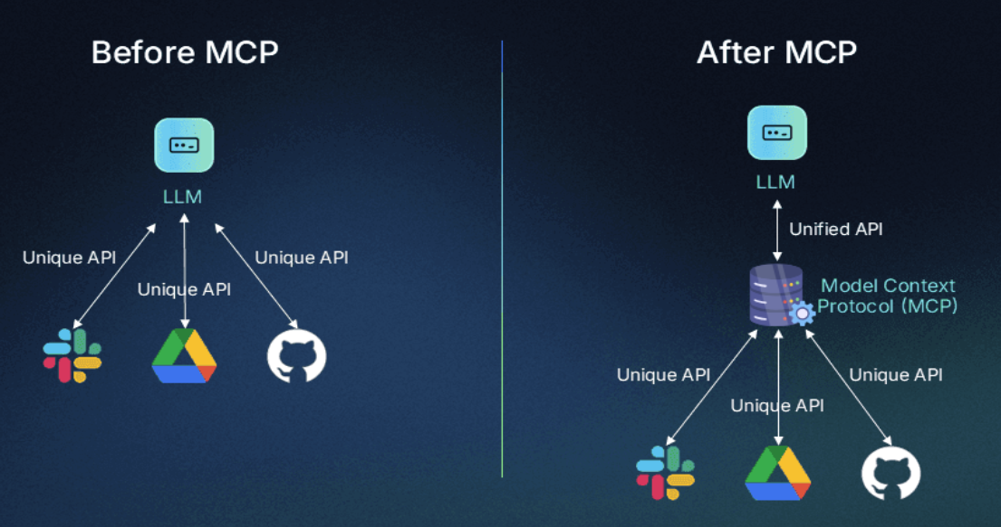
Why MCP IS Needed ?
Enables standard communication between models and tools
Ensures secure and controlled data access
Reduces custom integration effort
Supports scalable and reusable AI workflows
Notes:
Share a short example: 'Without MCP, each model-tool integration required custom adapters.'

Slide 6
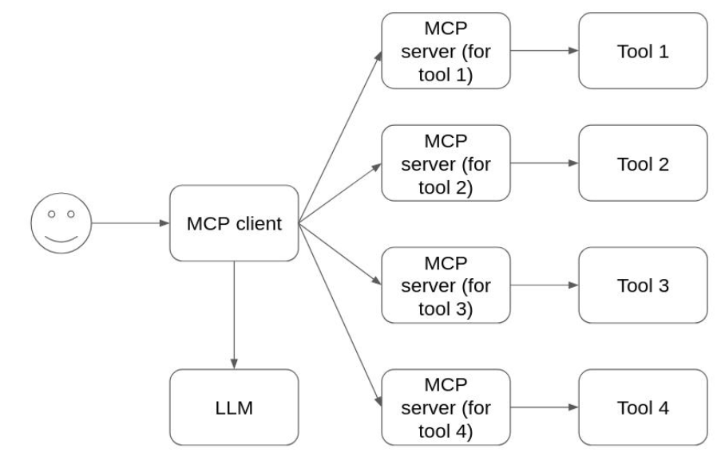
MCP Tools
External actions or functions a model can call
Examples: search API, CRM lookup, file upload, database query
Each tool has defined inputs, outputs, and permissions
Enables the model to perform real tasks safely

Slide 7
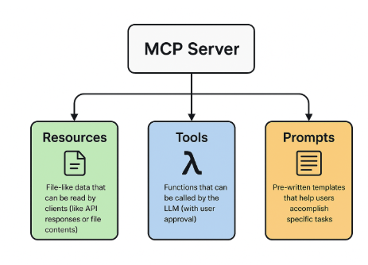
MCP Resources & Prompts
Structured data or knowledge sources the model can access
Examples: documents, databases, APIs, or files
Provide context and information for better model responses
Registered in the MCP server with metadata and access rules
Prompts - Pre-defined prompt templates or instructions

Slide 8
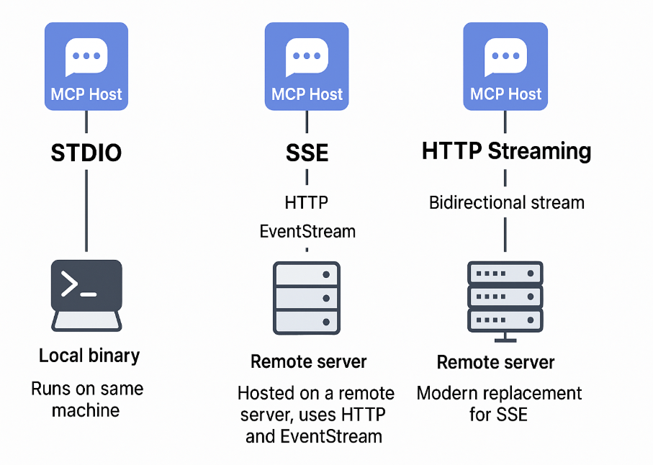
MCP Transport Mechanism
SSE (Unidirectional): Pushes real-time text/event-stream updates one way from server to client
Streamable HTTP (Bidirectional capable): Sends any data type in a continuous HTTP response, allowing two-way streaming if needed

Slide 9
Common MCP Authorization Techniques
API Key Authentication – Simple key-based access for basic tools and demos
OAuth 2.0 – Secure token-based access; ideal for enterprise & user-level permissions
JWT (JSON Web Token) – Signed tokens to verify identity and enforce scopes
Role-Based Access Control (RBAC) – Grants actions based on user or model roles
Scope-Based Permissions – Limits what data or tools a model can use (e.g., “read-only”)
Notes:
Show sequence diagram or flow: discover -> request -> execute -> return context.

Slide 10
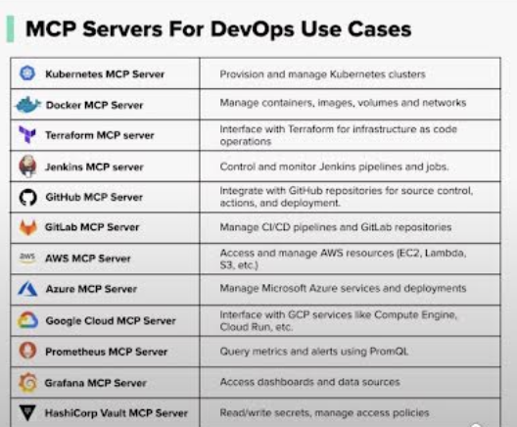
Notes:
Pick 1–2 use cases to demo live if possible.

Slide 11
FastMCP — The Standard Framework for Building MCP Applications
Handles all protocol complexities, so you focus on building
Just decorate a Python function — FastMCP manages the rest
Fast: High-level interface → less code, faster development
Simple: Minimal boilerplate for quick MCP server setup
Pythonic: Feels natural for Python developers
Complete: Built for production
Supports enterprise authentication (Google, GitHub, Azure etc)
Includes deployment tools, testing frameworks, and client libraries

Slide 12
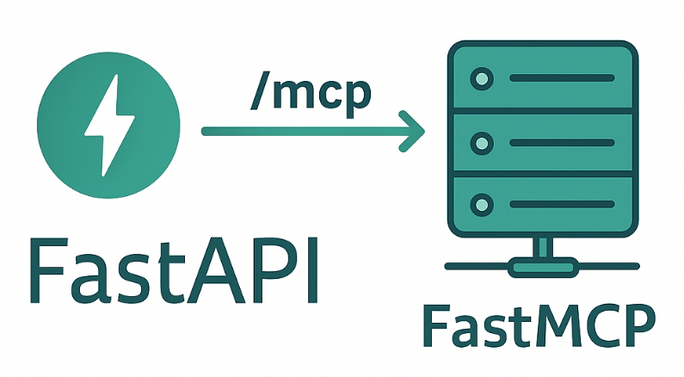
How FastAPI & FastMCP Work Together
FastAPI is a modern, high-performance Python web framework for building APIs.
FastAPI handles the HTTP requests, routing, and performance, while FastMCP handles MCP protocol logic (tools, resources, prompts)
Developers can define MCP endpoints easily using FastMCP decorators FastAPI manages the server, and FastMCP adds the MCP intelligence

Slide 13
Q/A
What is the primary purpose of the Model Context Protocol (MCP)?
How do MCP Tools, Resources, and Prompts differ?
Why is authorization important in MCP and what methods are commonly used?
How does FastMCP simplify MCP server development for Python developers?
What role does FastAPI play when building MCP applications with FastMCP?
Explain all 3 Transport Mechanism in MCPs

